Slide 1
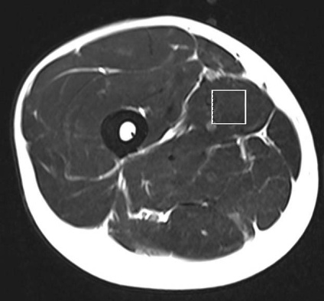
The Effects of Guanidinoacetic Acid Supplementation on Muscle Creatine Content
Sergej M. Ostojic¹, Patrik Drid¹, Jelena Ostojic², Jay R. Hoffman³
¹ Faculty of Sport and Physical Education, University of Novi Sad, Novi Sad, Serbia
² Clinical Center Vojvodina, Novi Sad, Serbia
³ University of Central Florida, Orlando, FL
Introduction
Guanidinoacetic acid (GAA, also known as glycocyamine, betacyamine or guanidinoacetate) is an experimental dietary additive that enhances serum creatine bioavailability and affects blood-derived metabolic markers of methylation in humans [1]. Since creatine is an important compound in cellular bioenergetics [2], a consumption of GAA has been recognized as an effective investigational intervention to facilitate creatine-mediated energy provision in health and disease [3]. At the same time, the methylation of GAA to form creatine consumes ~ 40% of available methyl groups, potentially depleting the sources of methyl groups in the body, including methionine, folate, betaine and choline [4]. However, no human study so far evaluated the effects of GAA consumption on creatine bioavailability and/or utilization of methyl groups in tissues with high-energy requirements, such as skeletal muscle or brain.
Methods
Figure 1. Location of individual VOI in right vastus medialis
Open-label case study in 4 healthy men
25 ± 3 yrs, BMI 24.3 ± 1.6 kg/m², physical activity 15 ± 2 h/wk)
Intervention= 3 grams per day of oral GAA
Treatment duration = 4 weeks
Evaluation = at baseline and after 4 weeks after the study commenced
Evaluation = 1.5 T MRS with 4-element body matrix receiver coil in right vastus medialis muscle (Figure 1)
Primary endpoint of treatment efficacy = change in muscle creatine levels from baseline to 4 week
Additional outcomes = muscle choline, intramyocellular and extramyocellular triglyceride, and muscle water
Results
Supplemental GAA significantly augmented total creatine levels by 15.9% (95% confidence intervals = -12.7 to 44.5%; P = 0.03) when averaged across subjects (Figure 2).
A trend has been found for increased choline concentration in the vastus medialis muscle (6.1% corresponding to 0.8 mM, P = 0.12) from before to after GAA administration (Figure 2). Myocellylar triglycerides and muscle water were not affected by the intervention (P > 0.05) (not presented).
Figure 2. Effects of 4-week guanidinoacetic acid (GAA) supplementation on muscle creatine (left panel) and muscle choline (right panel) in healthy men (n = 4). Asterisk (*) indicates significant differences baseline vs. after treatment at P < 0.05. Values are mean ± SD.
Conclusion
Supplemental GAA could be used as a novel experimental agent to positively affect creatine pool in the skeletal muscle of healthy men. This might be relevant for restoring cellular bioenergetics in both health and disease, including high-intensity exercise that depletes creatine stores, or disorders characterized by low muscle creatine, such as neurodegenerative diseases, mitochondrial myopathies, cachexia, or chronic fatigue syndrome.
References
Biography
SM Ostojic, MD, PhD, is
a head of Applied Bioenergetics
Lab at FSPE and Professor of Biomedical
Sciences at UNS; trained in medical physiology and nutrition, his recent research is focused on different mitochondria-targeted interventions in health and disease.
Scopus Author ID: 8552029600
[1] Ostojic SM et al. Eur J Nutr 2014;53:1637-43.
[2] Wallimann T et al. Amino Acids 2011;40:1271-96.
[3] Ostojic SM. Eur J Nutr 2015;54:1211-5.
[4] Obeid R. Nutrients 2013;5:3481-95.
This project was supported by the Serbian Ministry of Education, Science and Technological Development (Grant No. 175037), and the Faculty of Sport and Physical Education.

